Slide 1

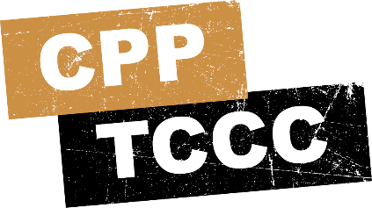


TACTICAL COMBAT CASUALTY CARE COURSE
MODULE 18: BURNS
Module 18: Burns
#TCCC-CPP-PPT-18 08 AUG 23
COMBAT PARAMEDIC/ PROVIDER
TCCC TIER 1
All Service Members
TCCC TIER 2
Combat Lifesaver
TCCC TIER 3
Combat Medic/Corpsman
TCCC TIER 4
Combat Paramedic/Provider

Slide 2




Module 18: Burns
TACTICAL COMBAT CASUALTY CARE (TCCC) ROLE-BASED TRAINING SPECTRUM
ROLE 1 CARE
NONMEDICAL PERSONNEL
MEDICAL PERSONNEL
YOU ARE HERE
STANDARDIZED JOINT CURRICULUM
#TCCC-CPP-PPT-18 08 AUG 23
2
Notes:
This module discusses the management of burns in the Tactical Field Care (TFC) setting, highlighting your role as a Combat Paramedic or Provider (CPP).
The assessment and management of a burn injury is taught during Combat Lifesaver and Combat Medic/Corpsman training, and it is important to understand what their training and anticipated skill set is in order to assume care for the casualty and potentially initiate more advanced treatments.

Slide 3
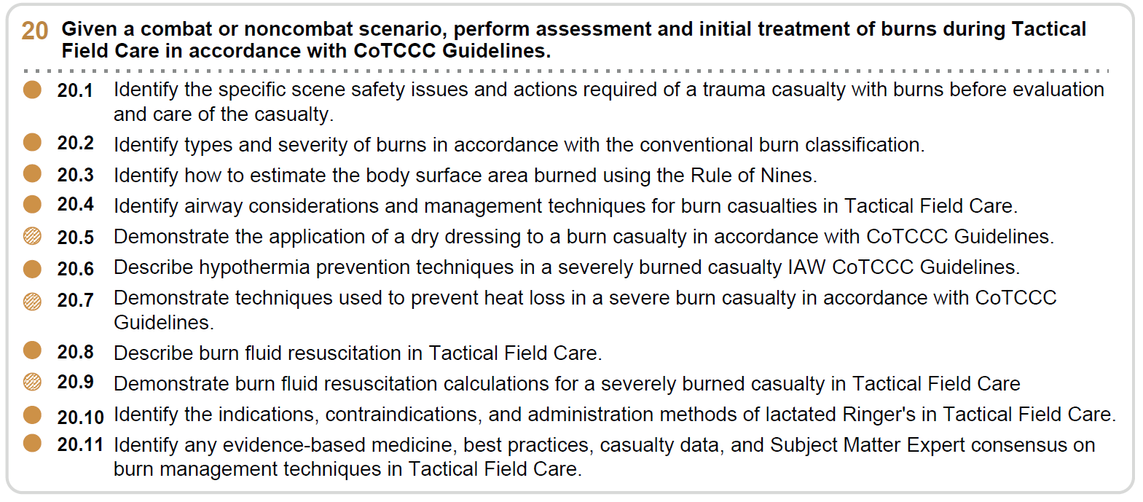










Module 18: Burns
1 x TERMINAL LEARNING OBJECTIVES
20 Given a combat or noncombat scenario, perform assessment and initial treatment of burns during Tactical Field Care in accordance with CoTCCC Guidelines.
  Identify the specific scene safety issues and actions required of a trauma casualty with burns before evaluation and care of the casualty.
  Identify types and severity of burns in accordance with the conventional burn classification.
  Identify how to estimate the body surface area burned using the Rule of Nines.
  Identify airway considerations and management techniques for burn casualties in Tactical Field Care.
  Demonstrate the application of a dry dressing to a burn casualty in accordance with CoTCCC Guidelines.
  Describe hypothermia prevention techniques in a severely burned casualty IAW CoTCCC Guidelines.
  Demonstrate techniques used to prevent heat loss in a severe burn casualty in accordance with CoTCCC Guidelines.
Describe burn fluid resuscitation in Tactical Field Care.
Demonstrate burn fluid resuscitation calculations for a severely burned casualty in Tactical Field Care
20.8
20.9
20.10 Identify the indications, contraindications, and administration methods of lactated Ringer's in Tactical Field Care.
20.11 Identify any evidence-based medicine, best practices, casualty data, and Subject Matter Expert consensus on burn management techniques in Tactical Field Care.
11 x ENABLING LEARNING OBJECTIVES
= Terminal Learning Objectives = Cognitive ELOs = Performance ELOs
#
#TCCC-CPP-PPT-18 08 AUG 23
3
Notes:
There are nine cognitive and three performance-enabling learning objectives covered in this module.
You will learn how to identify scene safety issues and actions required of a trauma casualty with burns before evaluation and care of the casualty, types and severity of burns, and how to estimate the percentage of the body surface involved in the burn.
You will also be able to identify progressive strategies and limitations for burn management in Tactical Field Care, describe burn fluid resuscitation, identify the indications, contraindications, and administration methods of lactated Ringer's, and describe the evidence supporting the progressive strategies, indications, and limitations of burn management techniques in Tactical Field Care.
The performance objectives involve learning how to apply a dry dressing, demonstrating techniques to prevent heat loss (hypothermia), and initiating burn fluid resuscitation when indicated.

Slide 4
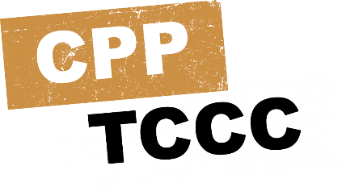
Three PHASES of TCCC
Module 18: Burns
1
CARE UNDER FIRE (CUF)
/ THREAT
2
TACTICAL FIELD CARE (TFC)
WORK UNDER COVER AND CONCEALMENT
3
TACTICAL EVACUATION CARE (TACEVAC)
RETURN FIRE AND TAKE COVER
MORE DELIBERATE ASSESSMENT AND PRE- EVACUATION PROCEDURES
NOTE: This is covered in more advanced TCCC training!
YOU ARE HERE
Notes:
Remember, you are now in the Tactical Field Care phase of care, so the focus has shifted from immediate life-threatening hemorrhage control while still under enemy fire in the Care Under Fire phase, to the reassessment of all previous interventions, followed by the prevention and treatment of other injuries and complications such as burns.

Slide 5
MARCH PAWS
Module 18: Burns
LIFE-THREATENING
AFTER LIFE-THREATENING
PAIN ANTIBIOTICS
WOUNDS SPLINTING
M A R C H
P A
MASSIVE BLEEDING
#1 Priority
AIRWAY
RESPIRATION (Breathing)
W
CIRCULATION
S
HYPOTHERMIA / HEAD INJURIES
Notes:
Burns are part of the “W” in the MARCH PAWS sequence, which stands for wounds

Slide 6


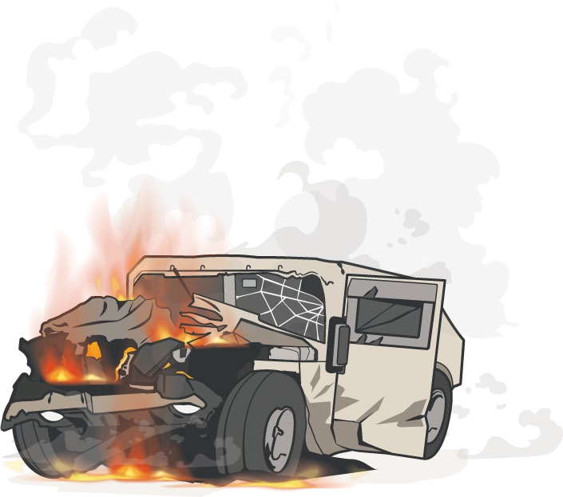

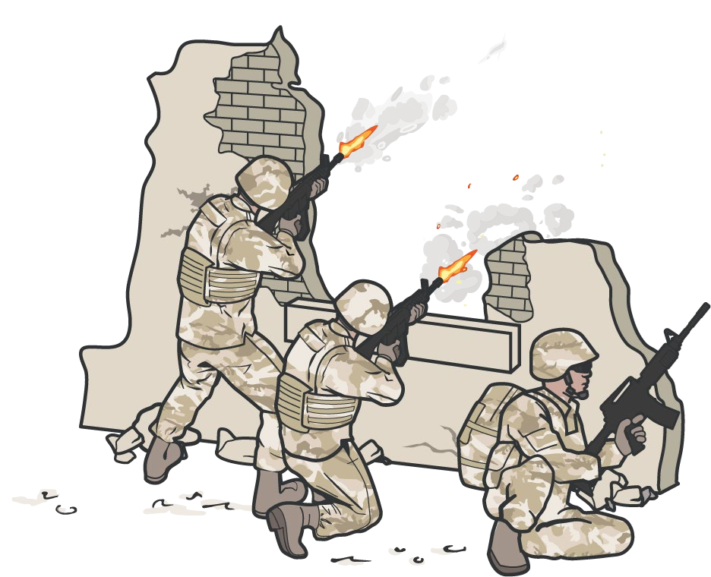
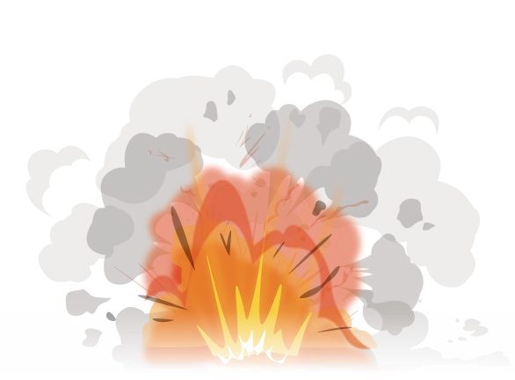


POTENTIAL BURN CAUSES IN TFC
Module 18: Burns
ELECTRICAL
THERMAL
FIREFIGHTS
EXPLOSION
IED / VBIED
VEHICLE/ AIRCRAFT CRASHES
CHEMICAL
P A W S
Notes:
Burns can happen during firefights, explosions, or vehicle or aircraft crashes. The source of the burn can be from exposure to electrical, thermal, or chemical events. These different sources have specific management principles for both you and the casualty’s safety and proper casualty treatment.

Slide 7
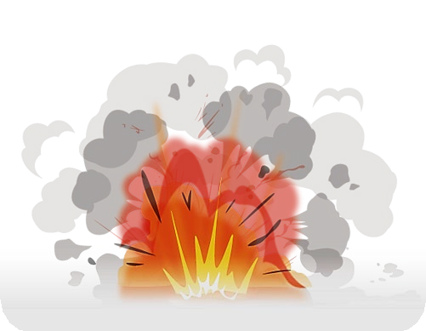
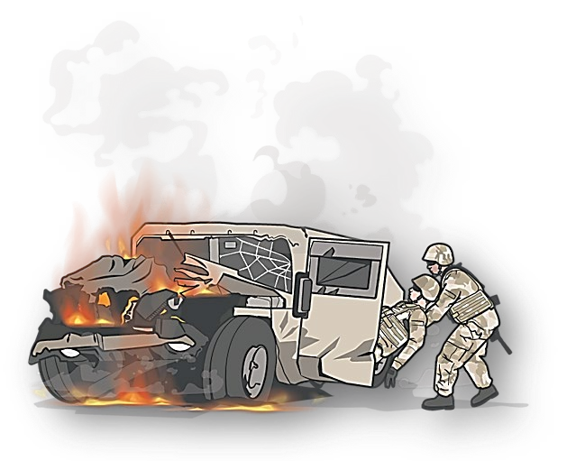
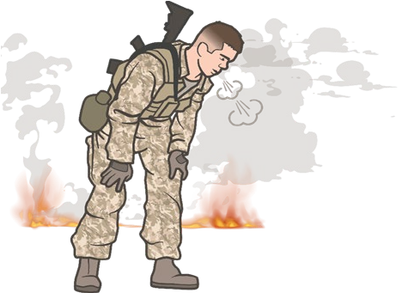
POTENTIAL BURN CAUSES IN TFC
Module 18: Burns
EXPLOSIONS (IED/VBIED)
Blast accounted for 82% of burn casualties; 80% were by IEDs
From 2001 – 2018:
2507 surviving service members sustained 5551 burn injuries while deployed
VEHICLE / AIRCRAFT CRASHES
65% burned while driving/riding in a vehicle; 23% dismounted
INHALATION INJURY
Inhalation injury in 10%
NOTE: 30% of all burn casualties sustained
P A
W
S
Traumatic Brain Injuries
Notes:
BURNS
From 2001 through 2018, 2507 surviving service members sustained 5551 burn injuries while deployed.
86% of the burned casualties were sustained during combat; 13% were non-battle injuries.
Blast accounted for 82% of burn casualties. Of those, 80% were by IEDs.
65% burned while driving/riding in a vehicle; 23% dismounted
Inhalation injury in 10%
The overwhelming majority of burns (92%) were considered small, affecting less than 20% TBSA.
Burns to the head, the most frequent burn site, comprising 29% of all burns.
The hands were the next most commonly burned location, accounting for 19% of all burns.

Slide 8

Module 18: Burns
BURNS
Video can be found on deployedmedicine.com

Slide 9


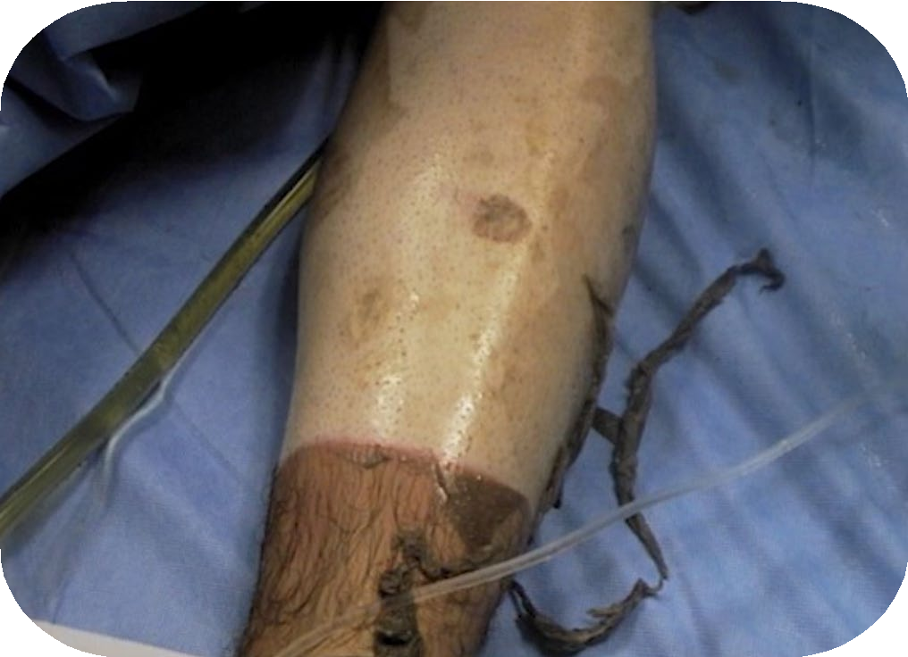
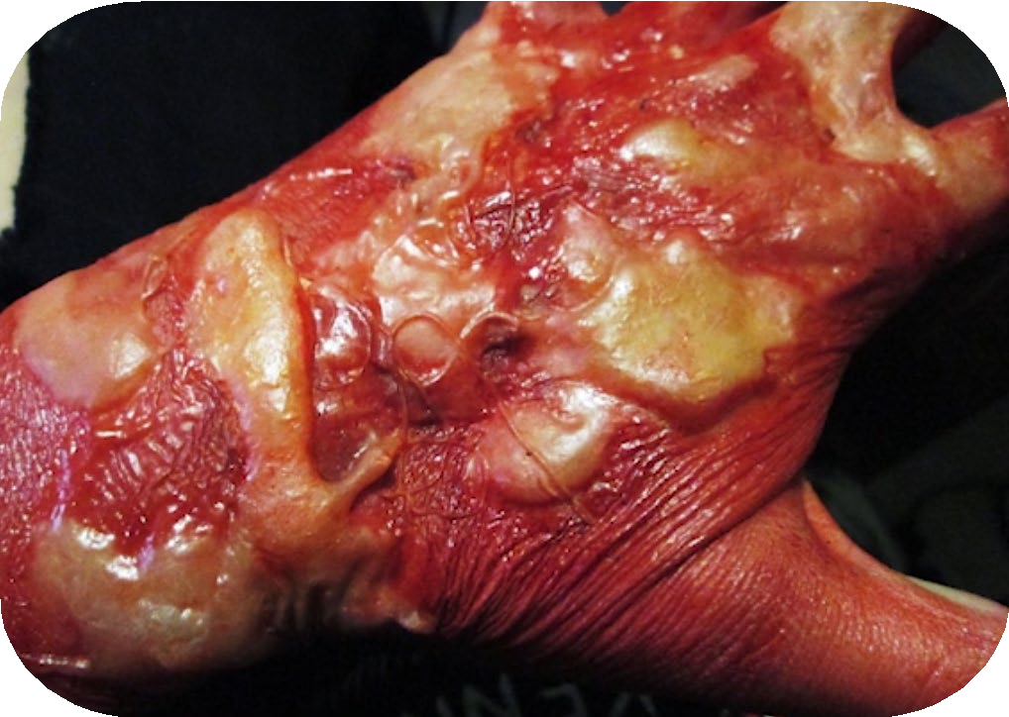
BURN WOUNDS
Module 18: Burns
BURN WOUNDS are an injury to skin or other tissues caused by heat, electricity, or chemicals and are present in 5% to 15% of combat casualties
Burn patients have unique management challenges and consideration.
The combination of burn and non- burn injuries results in a synergistic increase in mortality
The U.S. Army Institute of Surgical Research (USAISR) leads burn care efforts for the
U.S. military
Significant advancements in the care of burn casualties have been made in recent conflicts
P A
W
S
Notes:
Burn wounds are present in 5% to 15% of combat casualties. Although significant advancements in the care of burn casualties have been made in recent conflicts, burn patients still have unique management challenges and considerations. In fact, the combination of burn and non-burn injuries results in a synergistic increase in mortality.²
This can often be the result of inhalation injury, or burn shock superimposed on hemorrhagic shock, making management and treatment decisions critically important. Loss of the epidermal barrier causes a loss of moisture and fluids, loss of heat, lack of protection from infection, and initiation of an inflammatory process.
The U.S. Army Institute of Surgical Research (USAISR) leads burn care efforts for the U.S. military. They perform cutting-edge research to identify methods and techniques to improve outcomes in military burn casualties.

Slide 10
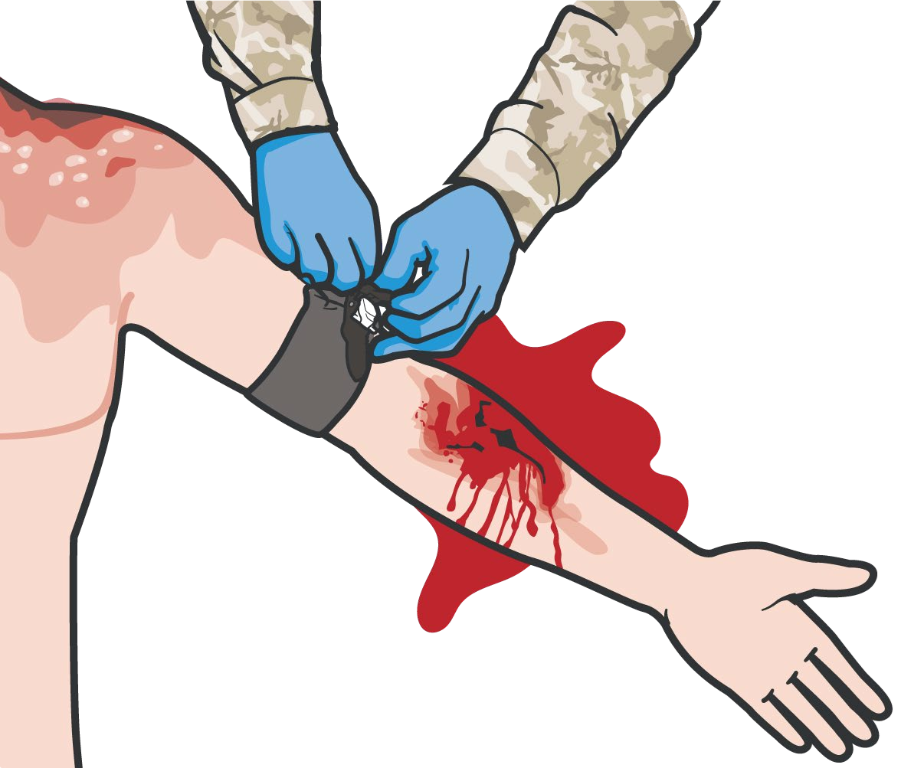

Module 18: Burns
FOLLOW MARCH PAWS
Follow the MARCH PAWS sequence to address ALL life- threatening injuries.
All trauma treatments can be performed on or through burned skin
Burn wounds may be distracting, despite the increase of synergistic mortality immediate death is unlikely
Depending on the source of the burn special consideration must be taken when providing care
REMEMBER: A burned trauma casualty is a trauma casualty first!
P A
W
S
Notes:
A burned casualty is a trauma casualty first.³ Although the burn wounds can be distracting, you must address all other life-threatening injuries using the MARCH PAWS sequence first. Remember, all trauma treatments can be performed on or through burned skin.

Slide 11
IN CASE OF
ELECTRICAL AND THERMAL INJURY
Module 18: Burns
Secure the power, if possible
Otherwise, remove the casualty from the electrical source using a nonconductive object, such as a wooden stick
Move the casualty to a safe place
STOP the sources of the burning
Assess and manage the burn, cut the clothing from around the burned area and gently lift it away
Be sure to avoid grabbing or further damaging burned areas
NOTE: If clothing is stuck to the burn, ensure you cut around the clothing and leave it in place
P A
W
S
Notes:
In an electrical injury, the first thing to do is secure the power, if possible. Otherwise, remove the casualty from the electrical source using a non-conductive object, such as a wooden stick. Then, move the casualty to a safe place. Low-voltage injuries such as wall outlets may cause arrhythmias in addition to burns.
High-voltage injuries such as high-tension wires may cause deep tissue injury and can result in an explosion which can lead to other blunt trauma injuries.
Thermal injury is the most common burn injury and involves direct damage to the skin and underlying structures by heat or flame.⁴ Since the temperature of the heat source and the time of contact with the skin determine the depth of the burn, the first step is to stop the source of the burning. This may entail smothering the flames or removing the casualty from the heat source, but always remember to protect yourself from getting burned while doing this.
Then, to assess and manage the burn, cut the clothing from around the burned area and gently lift it away. If the clothing is stuck to the burn, cut around the edges of the clothing that has adhered to the skin and leave it in place. Do not pull it off the burn. Be sure to avoid grabbing or further damaging burned areas by manipulating them during casualty movements.

Slide 12

Module 18: Burns
IN CASE OF CHEMICAL INJURY
Advise all first responders of the presence of a chemical burn
EXAMPLE
An example of a chemical is WHITE PHOSPHORUS
SOURCE
Commonly found incendiary in munitions; it is also found in fertilizers, pesticides, and fireworks
SIGNS & TREATMENTS
Ignites spontaneously in contact with air; produces yellow flame and white smoke in the wound bed
Submerse the burned area in water
Apply wet barrier (water-soaked gauze, clothing, mud, etc.) with an occlusive dressing
Patients with chemical burns should be deconned IAW Unit SOP
P A
W
S
Level of Evidence: B-NR
Notes:
Chemical burns can be caused by many different types of chemicals present in vehicles, machinery, and even some weapons.
An example of a chemical is white phosphorus. It can be found in tanks, mortar, and artillery rounds. Above 86ºF (30ºC), white phosphorus ignites spontaneously when in contact with air, producing a yellow flame and white smoke in the wound bed.
To prevent continued burning, submerse the affected area in water, if possible.
If submersion is not possible, the dressing must be wet, which can be done by applying a wet barrier – such as water-soaked gauze, clothing, or mud – and covering it with an occlusive dressing. Submersing the affected area removes the oxygen supply that causes the burning.
Advise all first responders of the presence of a chemical burn. This presents an increased risk to all providers and must be clearly communicated.
If absorbed, phosphate can bind with calcium and cause hypocalcemia as early as 1 hour after burn injury, so prompt evacuation to be monitored to prevent life-threatening arrhythmias.⁵
Most chemical compounds are removed by wiping off any dry material and irrigating the exposed areas with water. Hydrofluoric acid, commonly used in oil refining, glass manufacturing, and industrial cleaning agents, binds serum calcium and can lead to life-threatening hypocalcemia and tetany. In addition to irrigation with water, areas burned by hydrofluoric acid should be covered with 2.5% calcium gluconate gel (mix calcium gluconate with a lubricant like Surgilube).
White phosphorus is an incendiary agent used in some munitions. It is also found in fertilizers, pesticides, and fireworks. Above 86ºF (30ºC), white phosphorus ignites spontaneously when in contact with air, producing a yellow flame and white smoke in the wound bed. To prevent spontaneous ignition, the wound should be immediately immersed in water or saline, and then placed in water- or saline-soaked dressings. Furthermore, phosphate may be absorbed into the body. Phosphate binds with calcium, causing potentially life-threatening reduction in the level of calcium in the blood (hypocalcemia) and/or hyperphosphatemia as early as 1 hour after a burn injury. The electrocardiogram and calcium levels should be monitored to prevent life-threatening arrhythmias. (PHTLS)
The level of evidence supporting the guidance for the treatment of chemical burns in the tactical environment is based on a retrospective observational study.

Slide 13




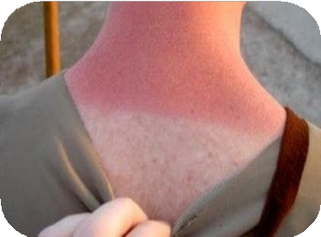
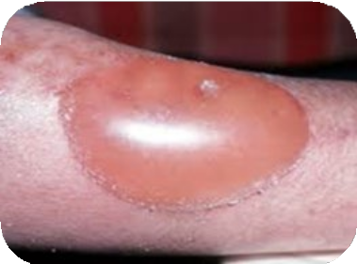
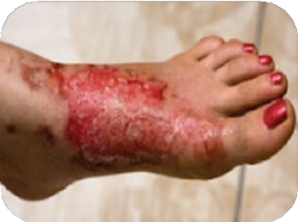
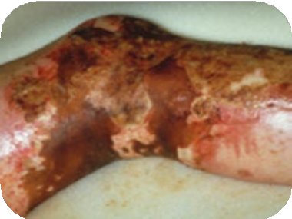
SEVERITY OF BURN
BURNS ARE CLASSIFIED BY THE DEPTH OF THE WOUND
Module 18: Burns
SUPERFICIAL
1ST DEGREE BURNS
These burns are painful and erythematous without blistering or open wounds. An example of a superficial burn is sunburn.
PARTIAL THICKNESS 2ND DEGREE BURNS
Bright red to mottled in appearance and wet to the touch. Blisters are commonly seen in superficial partial- thickness burns.
FULL THICKNESS 3RD DEGREE BURNS
May appear charred or whitish in color, dry, leathery, and insensate. Thrombosed blood vessels may be visible.
SUBDERMAL BURN 4th DEGREE BURNS
Subdermal burns extend through subcutaneous tissue into fascia, muscle, and even bone.
P A
W
S
Notes:
Burns range in severity. Here are visuals to help identify the severity of the burn, based on its depth.
SUPERFICIAL BURN (1st Degree)
Superficial, or first-degree burns, will appear reddened like a sunburn, which is painful and erythematous without blistering or open wounds. Burn depth is classified by depth of injury. A superficial burn injures only the epidermis. An example of a superficial burn is sunburn. Rapid wound healing occurs (< 1 week) without scarring. These burns are not included in the calculation of TBSA burned.
PARTIAL THICKNESS (2nd Degree)
Partial thickness, or second-degree burns, will also appear reddened but may also have blisters. These wounds tend to be bright red to mottled in appearance, and wet to the touch.
A partial-thickness burn destroys the epidermis and part of the dermis but does not extend through the entire dermis. Severe pain is caused by exposure of dermal nerve endings to air. It is important to leave blisters intact initially in the field because they act as a temporary “field dressing” for the injury.
Of greater concern are deep partial-thickness burns. These involve complete destruction of the epidermis and a variable amount of the dermis. Wounds are characteristically dark red to yellowish-white in color, minimally blanching, less moist than superficial partial-thickness burns, and exhibit decreased sensation to skin prick. Blisters can occur but are less common at this depth. Pain can vary, but in general, they hurt less secondary to destruction of pain fibers in the dermis.
Blood flow to areas with deep partial-thickness burns is compromised allowing for increased risk of infection and wound conversion to full-thickness injury.
FULL THICKNESS BURN (3rd Degree)
Full-thickness burns are characterized by injury of the epidermis, dermis, and underlying skin structures (hair follicles and glands). The burned tissue appears charred or whitish in color, dry, leathery, and insensate. Thrombosed blood vessels may be visible. This eschar is a potent stimulator of the inflammatory response and is a medium for microorganism growth.
These burns do not heal, and there is a high risk of hypertrophic scarring if they are not excised but rather allowed to close by contraction. Full-thickness burns may be relatively painless, so absence of pain does not correlate with the extent of the burn in severe cases.
SUBDERMAL BURN (4th Degree)
Subdermal Burns or fourth-degree burns extend through the subcutaneous tissue into fascia, muscle, and even bone.⁶ These patients require specialized burn care and reconstructive surgery.

Slide 14
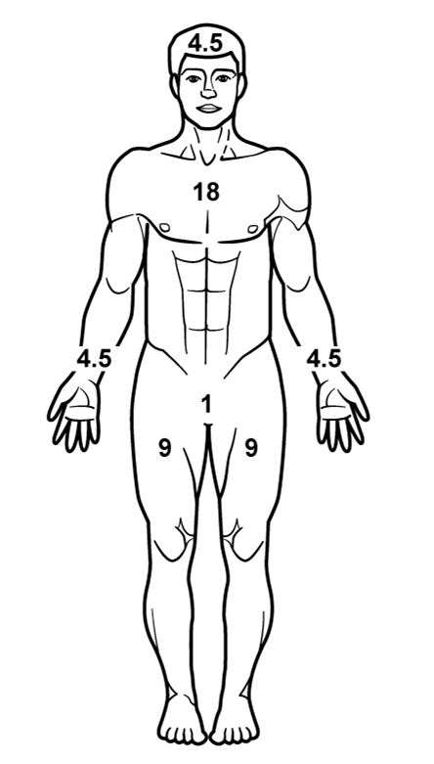
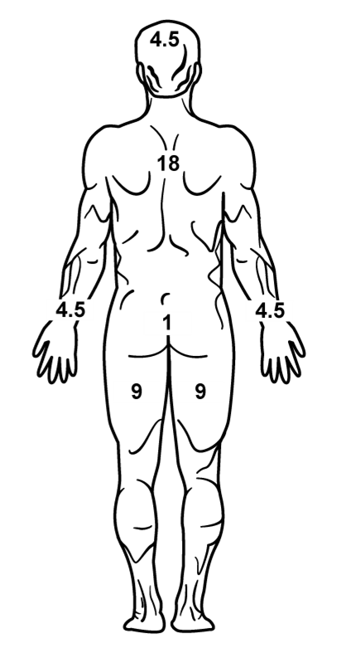
Module 18: Burns
RULE OF NINES
11 areas that each have 9% body surface area (head, upper extremities, front and back of lower extremities, and front and back of the torso having TWO 9% areas)
Palm size represents ~1%
Estimate/round up to nearest 10%
If half of the front or rear area is burned, the area would be half of the area value
Estimation Example:
Half of the front upper/lower extremity is 4.5% Half of the front upper/lower torso is 9%
DO NOT include first-degree wounds in this assessment
P A
W
S
Notes:
On the DD Form 1380, the percentage of coverage on the casualty’s body will need to be documented. The Rule of Nines will help with the estimation.⁷ The graphic here shows the approximation for each area of the body:
Eleven areas each have 9% body surface area (head, upper extremities, front and backs of lower extremities, and front and back of the torso having two 9% areas each). General guidelines are that the size of the palm of the hand represents approximately 1% of the burned area. When estimating, it is easiest to round up to the nearest 10. If half of the front or rear area is burned, the area would be half of the area value.
For example, if half of the front upper/lower extremity is burned, it would be half of 9%, or 4.5%. If half of the front torso is burned, say either the upper or lower part of the front torso, then it would be half of 18%, or 9%. Remember, the higher the percentage burned, the higher the chance for hypothermia.

Slide 15
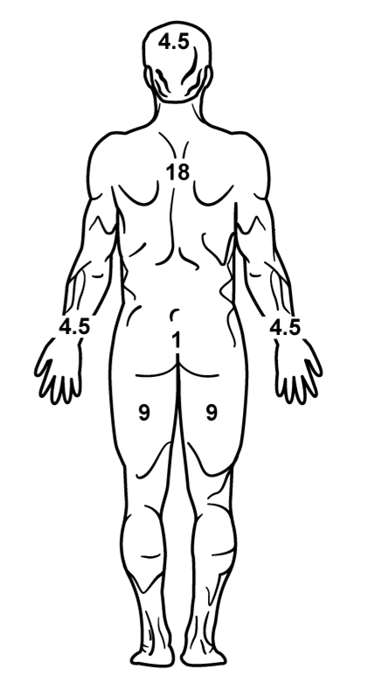


CALCULATING RULE OF NINES
Module 18: Burns
RULE OF NINES:
Left half of anterior
BURNED AREAS STATS
From 2001 through 2018, 2507 surviving SVMs
TBSA: 92% of burns were small < 20% TBSA
HEAD: Most frequent burn site 29% of all burns
HANDS: 2ND most frequent burn site 19% of all burns
9%
9%
9%
torso
Front and back of left upper extremity
Anterior portion of left lower extremity
Area (TBSA) Burned =
27%
Total Body Surface
NOTE: For estimation of fluid resuscitation requirements this would be rounded up to 30%
P A
W
S
Notes:
In this example, the areas burned are the left side of the anterior torso, which is 9%, the entire left upper extremity, front and back, which is 9%, and the front of the left lower extremity, which is also 9%. This adds up to a total body surface area burned of 27%. If you are going to use this for estimation of fluid resuscitation, you would round this up to 30%.⁸

Slide 16
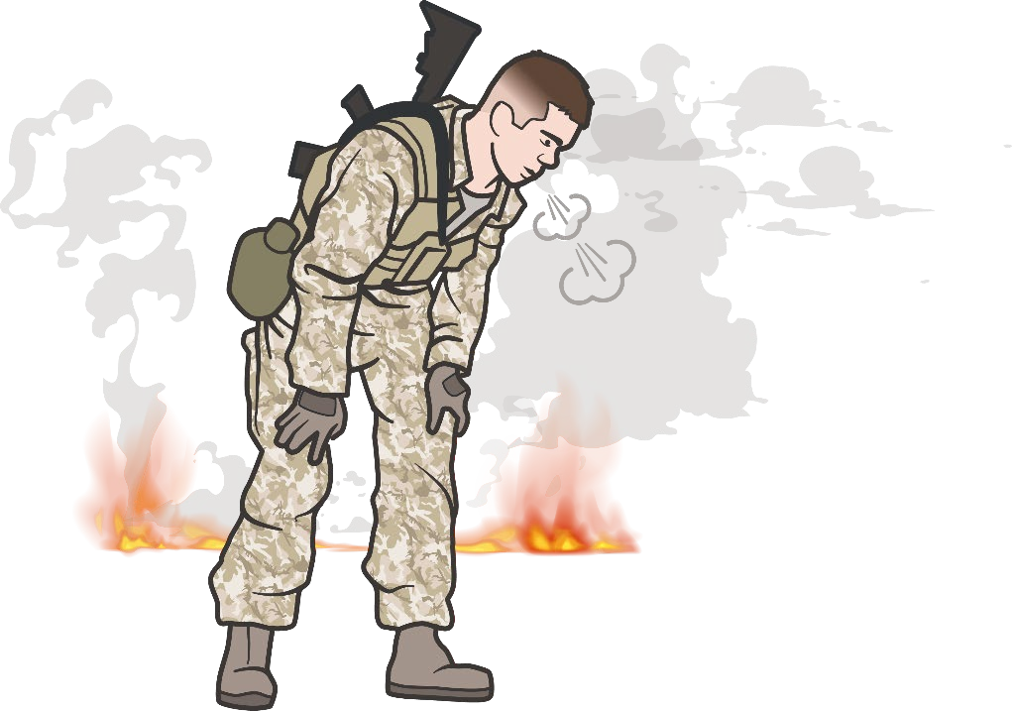

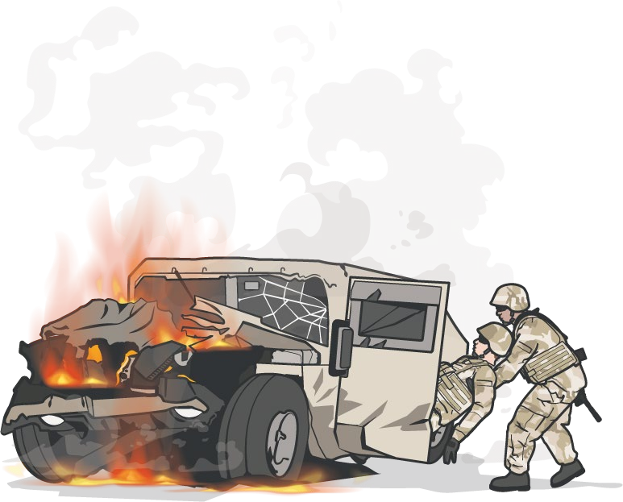
Module 18: Burns
AIRWAY MANAGEMENT IN BURN CARE
STOP the burning process immediately!
If the casualty was in an enclosed space such as a vehicle, a building, or a burning compartment in a ship at sea, suspect inhalation injury
27% of combat burn casualties had an associated inhalation injury
Findings suggestive of
Inhalation Injury include:
Facial burns
Carbonaceous sputum
Stridor
Hoarseness
Cough
P A
W
S
Level of Evidence: C-LD
Notes:
Inhalation injury can cause difficulties with the airway and breathing. Inhalation injury should be suspected if the casualty was in an enclosed space such as a vehicle, a building, or a burning compartment in a ship at sea. Clinical exam findings suggestive of inhalation injury include facial burns, carbonaceous sputum, stridor, hoarseness, or cough. In these patients, special attention must be paid to the airway.
Facial burns, especially those that occur in closed spaces, may be associated with inhalation injury. Aggressively monitor airway status and oxygen saturation in such patients and consider early surgical airway for respiratory distress or oxygen desaturation.⁹ Increasing percentage of total body surface area burned, flame, enclosed space, face burns, hoarse voice, soot in mouth, and shortness of breath were predictive of inhalation injury. 27% of combat burn casualties had an associated inhalation injury.¹⁰
The level of evidence supporting the guidance for airway management in burn casualties in the tactical environment is based on retrospective observational registry studies and retrospective observational registry studies with limitations.

Slide 17

Module 18: Burns
AIRWAY MANAGEMENT IN BURN CARE (cont.)
AIRWAY CONSIDERATIONS
Facial burns, especially in closed spaces, may be associated with inhalation injury
Aggressively monitor airway status and oxygen saturation
NPAs and EGAs may not suffice for respiratory distress or oxygen desaturation, an advanced airway may be required
Ensure the ETT in casualties with facial burns is critical to prevent catastrophic airway loss
Burn casualties may also require intubation due to decreased mental status
RESPIRATION CONSIDERATIONS
Follow airway evaluation with assessment of bilateral breath sounds and pulse oximetry
The presence of an inhalation injury may cause delayed respiratory failure that can occur 15 to 60 minutes after the injury
Burning compounds can release a variety of chemicals such as carbon monoxide and cyanide, all burn casualties should receive 100% oxygen
Full-thickness burns across the chest can impair breathing by inhibition of chest wall motion
P A
W
S
Level of Evidence: C-LD
Notes:
Inhalation injury can quickly compromise the airway due to edema and you must be ready for early intervention and possibly the need for an advanced airway. They may require a surgical airway to bypass the edema of the upper airway and oropharynx. These casualties should be monitored closely for potential airway issues.¹² Do not place an NPA or extra-glottic in a casualty with signs of inhalation injury, as a surgical airway should be performed for signs of airway compromise in a burn casualty.
Burn casualties may also require intubation due to decreased mental status, which may be caused by low oxygen levels in the fire environment, inhalation of toxic gases (see later), head injury, or hypovolemic shock. Securing the endotracheal tube in casualties with facial burns is critical to prevent catastrophic airway loss because the adhesive tape does not stick to the skin in a burned casualty – not even to normal skin. Therefore, cotton ties (umbilical tape), or other devices for securing the tube all the way around the head and neck, are required.
Some burn casualties are at increased risk of cervical spine injury. These include casualties who have sustained motor vehicle collisions, falls, high-voltage electric injuries, or blast injuries. In these casualties, cervical spine stabilization is important.
The presence of an inhalation injury may cause delayed respiratory failure that can occur 15 to 60 minutes after the injury.
Respirations
Assessment of bilateral breath sounds and pulse oximetry (hemoglobin oxygen saturation, or SpO₂) follows airway evaluation. Processes in combat casualties that may compromise breathing include:
Hemothorax
Pneumothorax
Rib fractures
Open pneumothorax
Tracheal injury
Pulmonary contusion
The presence of an inhalation injury may cause delayed respiratory failure that can occur 15 to 60 minutes after the injury.
Burning compounds can release a variety of chemicals. Fires involving wood, charcoal, natural gas, petroleum, or similar compounds release carbon monoxide (CO). CO impairs the ability of hemoglobin to carry oxygen and can cause symptoms of decreased oxygenation ranging from nausea and headache to myocardial infarction, mental status changes, and death. It binds powerfully with hemoglobin, turning the blood bright red and producing misleading (i.e., not low) SpO₂ readings. Therefore, all burn patients should receive 100% oxygen until a measurement of the carboxyhemoglobin level and arterial oxygen partial pressure can be obtained in the emergency department.
Fires involving materials like plastics and foam may release cyanide (CN). CN gas is also a chemical warfare agent. CN compromises the cells’ ability to use oxygen. No rapid test exists for the diagnosis of CN poisoning. Signs include:
Loss of consciousness
Hypotension
Lactic acidosis
Cardiopulmonary arrest
CN poisoning is treated with intravenous (IV) hydroxocobalamin (e.g., Cyanokit®), a form of high-dose vitamin B12; any burn casualty that is unconscious from a burn injury in an enclosed space should receive a Cyanokit.
Full-thickness burns across the chest can impair breathing by inhibiting of chest wall motion, creating a straitjacket-like effect. These patients will be difficult to ventilate using a bag-mask device due to chest wall restriction and may suffer cardiopulmonary arrest. In this situation, immediate chest escharotomy (by a qualified provider) is required to create room for the chest to expand.
Burn/Airway Management
The National Burn Repository of the American Burn Association reports up to 10.3% of burn patients have concomitant inhalation injury COMPARED TO 27% of combat burn casualties who had an associated inhalation injury.¹⁰
14% of 235 burn casualties underwent prehospital airway management.¹³
Of 1148 burn admissions; 11% had confirmed inhalation injury; the Mortality of those with inhalation injury was 16%; Increasing percentage of total body surface area burned, flame, enclosed space, face burns, hoarse voice, soot in mouth and shortness of breath were predictive of inhalation injury.¹⁴
The level of evidence supporting the guidance for airway management in burn casualties in the tactical environment is based on retrospective observational registry studies and retrospective observational registry studies with limitations.

Slide 18


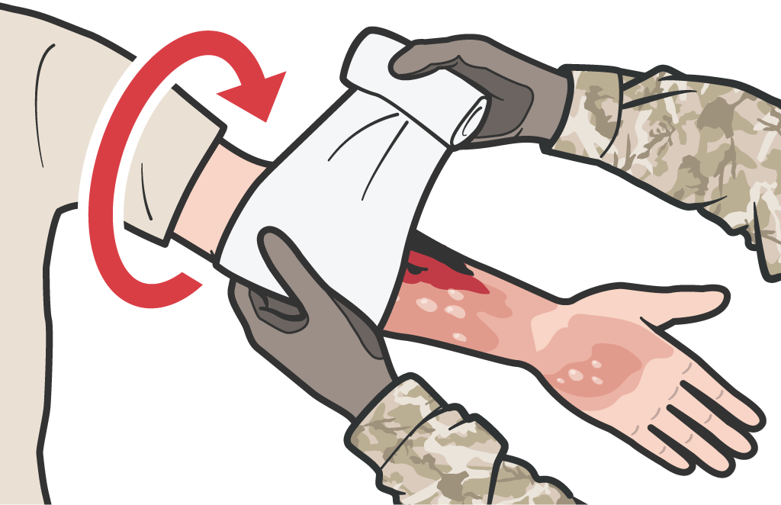

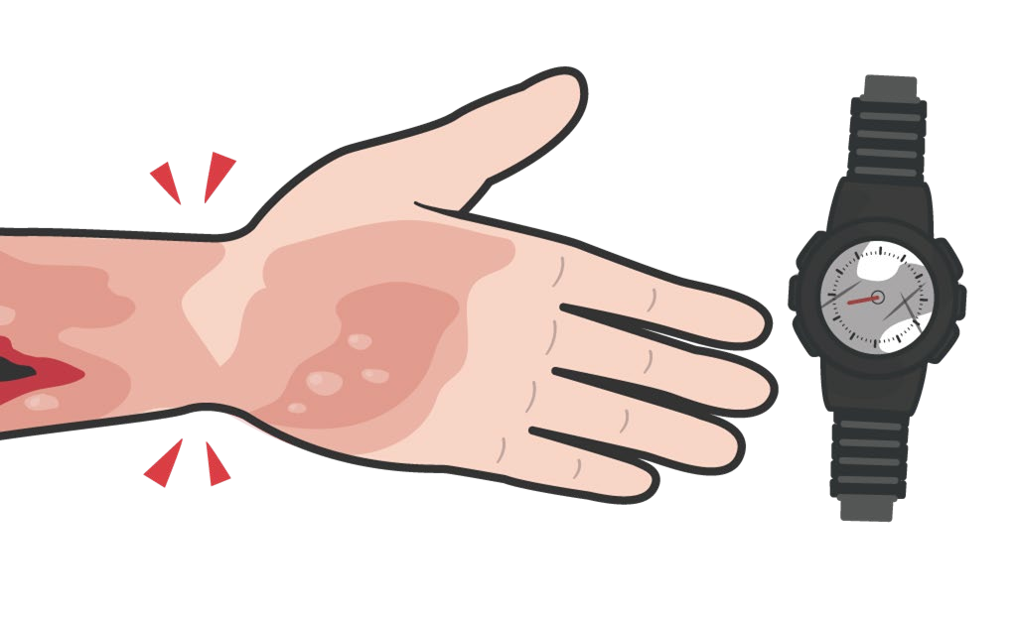
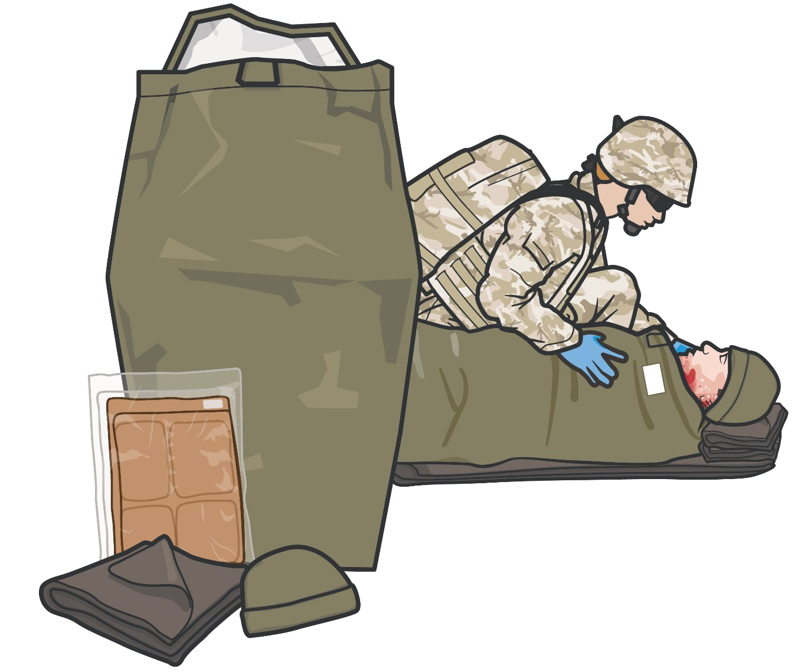
Module 18: Burns
BURN CARE
REMOVE watches and jewelry from burned area
COVER the burn area with dry, sterile dressings
HYPOTHERMIA PREVENTION
For extensive burns (>20%), place the casualty in a Heat-Reflective Shell or Blizzard Survival Blanket
IMPROVISED DRESSINGS include
clean dry clothing or sheets
NOTE: Loosely wrap dressings to avoid constricting burned skin to allow for swelling
NOTE: For large surface area burns, the HPMK can act as a dressing in addition to hypothermia management
P A
W
S
Notes:
All TCCC procedures can be performed on or through burned skin in a burn casualty.¹⁵ Remove all watches and jewelry from the burned area so they don’t cause constriction when swelling occurs. Cover the burned area with a dry, sterile dressing, if possible.
For extensive burns (>20%), consider placing the casualty in the Heat-Reflective Shell or Blizzard Survival Blanket from the Hypothermia Prevention Kit in order to both cover the burned areas and prevent hypothermia. Improvised dressings include clean dry clothing or sheets (avoid material with loose fabric pieces). Clean plastic wrap or bag cut and secured over burn wound (plastic should not be wrapped around limb or torso).

Slide 19
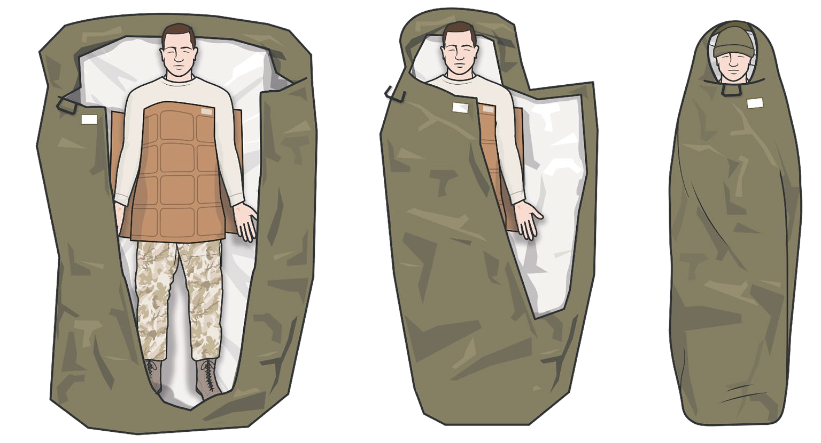

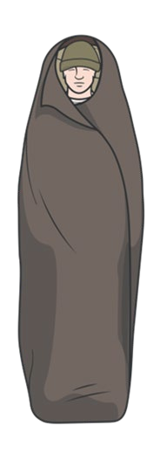
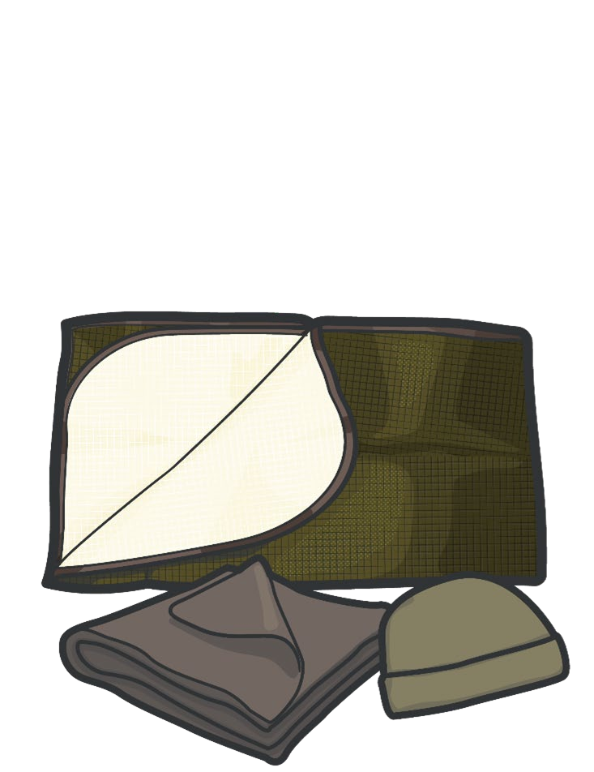

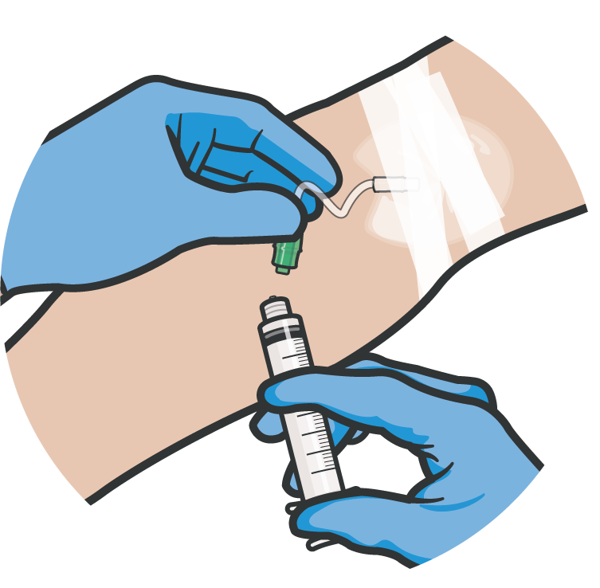
BURN CARE AND HYPOTHERMIA PREVENTION
Module 18: Burns
For EXTENSIVE BURNS (>20%),
PASSIVE
Warming Supplies
consider using ACTIVE warming supplies to cover the burned areas and prevent hypothermia
ANALGESIA may be administered to treat burn pain
ANTIBIOTIC therapy NOT indicated solely for burns
Burn patients are particularly susceptible to hypothermia
Extra emphasis should be placed on barrier heat loss prevention methods
P A W S
18
Notes:
AKE EARLY and aggressive steps to prevent further body heat loss.
Always be mindful of burns along with massive bleeding. Ensure bleeding is controlled first.
Burn patients are particularly susceptible to hypothermia. Extra emphasis should be placed on barrier heat loss prevention methods.¹⁶ Keep casualties off the ground and onto an insulated surface as soon as possible.
For extensive burns, those with >20% of the area burned, consider placing the casualty in the vapor barrier shell to cover the burned areas and prevent hypothermia.
Regardless of ambient temperature in the environment, actively prevent/manage hypothermia for burn patients using these methods.
Be mindful of warm weather and cool weather interventions. The addition of blood loss can cause the body’s temperature to drop even when it is hot outside. Never cover a tourniquet; keep it visible so medical personnel can easily see it.
Analgesia may be administered to treat burn pain. Antibiotic therapy is not indicated solely for burns but should be given to prevent infection in penetrating wounds.¹⁷

Slide 20
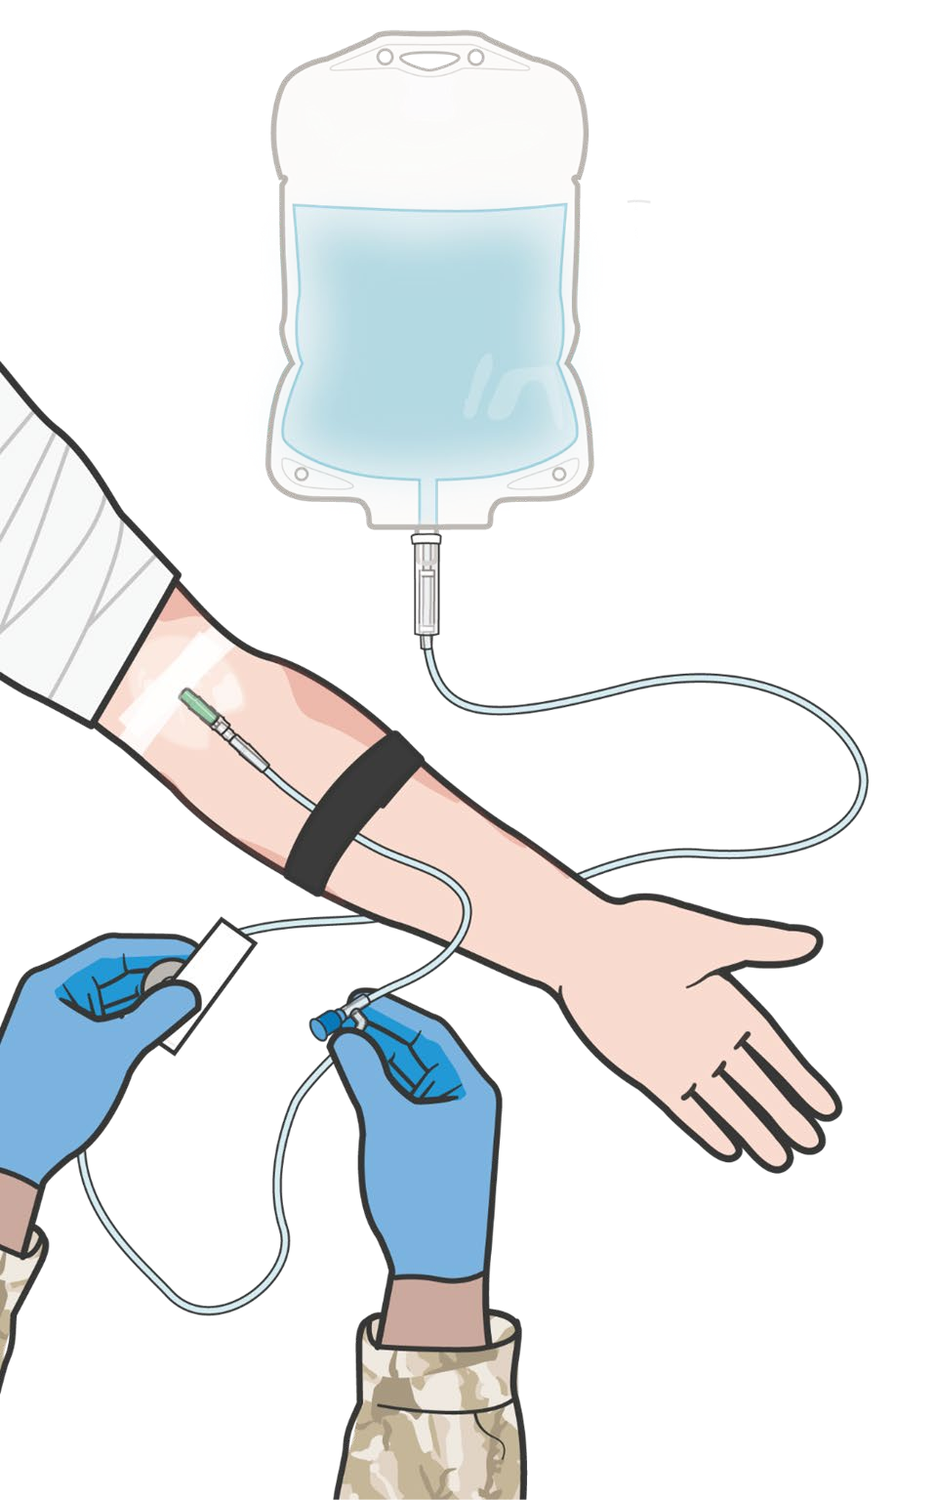
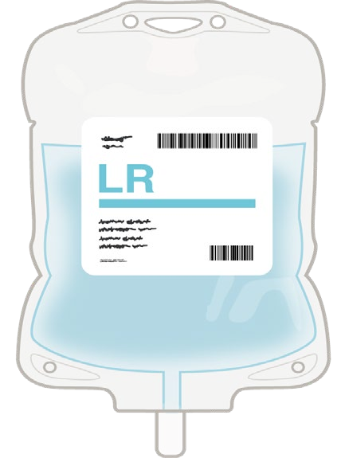

BURN FLUID RESUSCITATION
Module 18: Burns
Use Lactated Ringer’s and normal saline
(If Hextend® is used, no more than
Fluid resuscitation for burn casualties is guided by the
USAISR Rule of Ten
For burns > 20% TBSA, initiate fluid resuscitation as soon as IV/IO access established
For burns ≤ 30% TBSA, consider administration of oral fluids, if casualty is conscious and able to swallow
1000 ml should be given, followed by
lactated Ringer’s or normal saline as
needed)
Initial IV/IO fluid rate is %TBSA x 10 ml/hr for adults 40-80 kg
NOTE: For every 10 kg ABOVE 80 kg, increase initial rate by 100 ml/hr
REMEMBER: If hemorrhagic shock is also present, resuscitation for hemorrhagic shock takes precedence over resuscitation for burn shock
Level of Evidence: C-LD
P A W S
Notes:
Fluid resuscitation for burn casualties is guided by the USAISR Rule of Ten.¹⁸ For burns > 20% TBSA, initiate fluid resuscitation as soon as IV/IO access is established.¹⁹
The level of evidence supporting the guidance for the strategies and techniques for burn resuscitation in the tactical environment is based on a meta-analysis of retrospective observational studies and lab evaluations with limitations.
REMEMBER:
If hemorrhagic shock is also present, resuscitation for hemorrhagic shock takes precedence over resuscitation for burn shock.
Use lactated Ringer’s, normal saline, or Hextend®. If Hextend is used, no more than 1000 ml should be given, followed by Lactated Ringer’s or normal saline as needed.
The initial IV/IO fluid rate is the %TBSA x 10 ml/hr for adults weighing 40-80 kg. For every 10 kg above 80 kg, increase the initial rate by 100 ml/hr.
Consider using oral fluids for burns up to 30% TBSA if the casualty is conscious and able to swallow.^{19, 20}

Slide 21
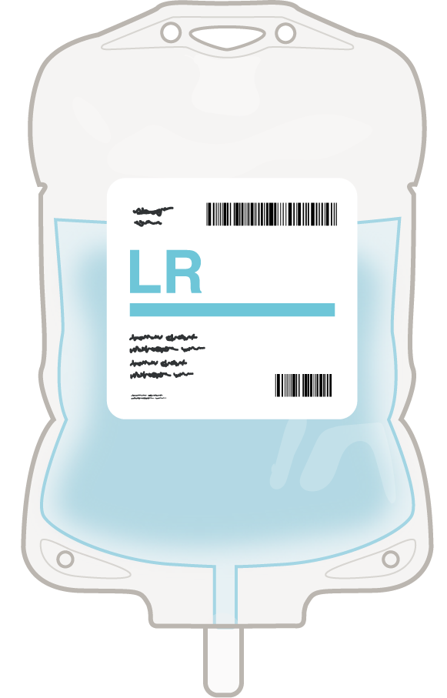
Module 18: Burns
ADMINISTRATION OF LACTATED RINGERS IN TACTICAL FIELD CARE
Lactated Ringers is indicated in:
CONTRAINDICATIONS:
Burns greater than 20% TBSA
Provides electrolytes, calories, and source of water for hydration
Heart failure, renal failure, or suspected hyperkalemia, severe metabolic acidosis or alkalosis, severe liver disease or anoxic states
DO NOT administer Lactated Ringer’s Injection, simultaneously with citrate anticoagulated/preserved blood through the same administration set
TACTICAL CONSIDERATIONS:
ROUTES OF ADMINISTRATION:
Intravenous (IV)/Intraosseous (IO)
Monitor closely for signs of circulatory overload
Use caution in casualties with hypervolemia, renal insufficiency, urinary tract obstruction, or impending or frank cardiac decompensation
SUPPLY:
POTENTIAL SIDE EFFECTS:
250ml, 500ml, and 1000ml bags
Allergic reactions, fever, infection at injection site, or redness/red streaking and swelling from the site of injection
SOLUTION CLASS:
Isotonic Crystalloid Solution
DRUG INTERACTIONS:
Ceftriaxone, Corticosteroids or Corticotropin
Notes:
DOSAGE AND ADMINISTRATION
Important Administration Instructions
Lactated Ringer’s Injection, USP is intended for intravenous administration using sterile equipment. Use a dedicated line without any connections to avoid air embolism. Do not administer Lactated Ringer’s Injection, USP simultaneously with citrate anticoagulated/preserved blood through the same administration set because of the likelihood of coagulation precipitated by the calcium content of Lactated Ringer’s Injection, USP.
INDICATIONS AND USAGE
Lactated Ringer’s Injection, USP is indicated as a source of water and electrolytes or as an alkalinizing agent.
CONTRAINDICATIONS
Do not administer Lactated Ringer’s Injection, USP simultaneously with citrateanticoagulated/preserved blood through the same administration set because of thelikelihood of coagulation precipitated by the calcium content of Lactated Ringer’sInjection, USP.
Hypersensitivity Reactions
Hypersensitivity reactions, including anaphylaxis, have been reported with Lactated Ringer’s Injection, USP (see ADVERSE REACTIONS). Stop the infusion immediately if signs or symptoms of a hypersensitivity reaction develop. Appropriate therapeutic countermeasures must be instituted as clinically indicated.
Fluid Overload
Depending on the volume and the rate of infusion, the intravenous administration of Lactated Ringer’s Injection, USP can cause electrolyte disturbances such as overhydration and congested states, including pulmonary congestion and edema. Avoid Lactated Ringer’s Injection, USP in patients with or at risk for fluid and/or solute overloading. If use cannot be avoided, monitor fluid balance, electrolyte concentrations and acid base balance, as needed and especially during prolonged use.
Hyperkalemia
Potassium-containing solutions, including Lactated Ringer’s Injection, USP, may increase the risk of hyperkalemia.
Patients at increased risk of developing hyperkalemia include those:
with conditions predisposing to hyperkalemia and/or associated with increased sensitivity to potassium, such as patients with severe renal impairment, acute dehydration, extensive tissue injury or burns, or certain cardiac disorders such as congestive heart failure.
treated concurrently or recently with agents or products that cause or increase the risk of hyperkalemia (see PRECAUTIONS, Drug Interactions).
Avoid use of Lactated Ringer’s Injection, USP in patients with, or at risk for, hyperkalemia. If use cannot be avoided, monitor serum potassium concentrations.
Alkalosis
Because lactate is metabolized to bicarbonate, administration of Lactated Ringer’s Injection, USP may result in, or worsen, metabolic alkalosis. Avoid intravenous administration of Lactated Ringer’s Injection, USP in patients with alkalosis or at risk for alkalosis.
DRUG INTERACTIONS
Ceftriaxone, for information on interaction with ceftriaxone
Other Products that Affect Fluid and/or Electrolyte Balance
Administration of Lactated Ringer’s Injection, USP to patients treated concomitantly with drugs associated with sodium and fluid retention may increase the risk of hypernatremia and volume overload. Avoid use of Lactated Ringer’s Injection, USP in patients receiving such products, such as corticosteroids or corticotropin. If use cannot be avoided, monitor serum electrolytes, fluid balance and acid-base balance.
ABA guidelines recommend initiating fluid resuscitation of the burn patient by using lactated Ringer’s solution at a rate of infusion based on 2 mL/kg/% to 4 mL/kg/% total body surface area (TBSA) burn administered over the first 24 hours postburn, providing one-half of the estimated fluid over the first 8 hours and the remainder over the next 16 hours. Once this initial fluid rate is calculated and initiated, an optimal resuscitation can only occur with an attentive bedside clinician carefully titrating fluids based on patient response. Regardless of the formula used, each requires the same multiple steps to derive in the initial fluid rate and thus is too cumbersome for combat prehospital providers who often must assess and resuscitate several burn patients simultaneously.
To simplify the derivation of the initial fluid rate, we developed the following formula:
Estimate burn size to the nearest 10.
%TBSA 10 initial fluid rate in mL/hr (for adult patients weighing 40 kg to 80 kg).
For every 10 kg above 80 kg, increase the rate by 100 mL/hr.
Once fluid resuscitation is initiated, our ultimate goal is to maintain end-organ perfusion by gradually restoring fluid balance while simultaneously replacing insensible losses and avoiding the consequences of both under- and over-resuscitation. Our objective was to determine whether this approach would result in an appropriate initial fluid rate when compared with existing resuscitation formulas.

Slide 22
BURN FLUID CALCULATION PRACTICE
Module 18: Burns
NOTE: For estimation of fluid resuscitation requirements round TBSA to the nearest 10
Using the USAISR Rule of Ten (%TBSA x 10 ml/hr for adults 40-80 kg) calculate the burn resuscitation fluid rate required:
Example #1: 36-year-old SVM with 27% TBSA (2nd and 3rd degree) burned who weighs 74kg:
BURNED AREAS:
Left half of anterior
9%
9%
9%
torso
Front and back of left upper extremity
Anterior portion of left lower extremity
30 (%TBSA) x 10 (ml/hr) = 300ml/hr
Example #2: 22-year-old SVM 54% TBSA (2nd and 3rd degree) burned who weighs 95kgs:
27% =
Total Body Surface Area (TBSA) Burned
50 (%TBSA) x 10 (ml/hr) + 100
(*10kg) = 600ml/hr
NOTE: *For every 10 kg ABOVE 80kg, increase initial rate by 100 ml/hr
P A W S
Notes:
In this example, the areas burned are the left side of the anterior torso, which is 9%, the entire left upper extremity, front and back, which is 9%, and the front of the left lower extremity, which is also 9%. This adds up to a total body surface area burned of 27%. If you are going to use this for estimation of fluid resuscitation, you would round this up to 30%.³
NOTE:
For estimation of fluid resuscitation requirements round TBSA to the nearest 10 (if the TBSA is less than 5 round down to the closest ten, if the TBSA is above 5 round up to the nearest ten) e.g., 54% rounds down to 50%.

Slide 23

SKILL STATION
Module 18: Burns
Burn Treatment (Skill)
Burn Dressing and Hypothermia Prevention
Burn Fluid Resuscitation Administration
Notes:
The following skill cards will demonstrate burn dressing and hypothermia prevention as well burn fluid resuscitation administration.

Slide 24
Module 18: Burns
EVIDENCE SUPPORTING BURN TREATMENT STRATEGIES
Subject Category | Study Types | Level of Evidence
Strategies & Techniques for Burn Resuscitation | Meta-analysis of retrospective observational studies; lab evaluations with limitations | C-LD
Treatment of Chemical Burns | Retrospective observational study | B-NR
Airway Management | Retrospective observational registry study & Retrospective observational study with limitations | C-LD
Notes:
The levels of evidence support the guidance for strategies and techniques in burn fluid resuscitation, however, there are many acceptable strategies. The treatment of chemical burns is guided by basic chemistry, but the techniques applied to weapons and wounds of war create a low to moderate level of evidence.
Airway management does not lend itself to interventional trials, as these are life-threatening airway problems if not treated appropriately. For that reason, there will only be expert consensus leading to a low to moderate quality of evidence.
There is significant evidence in trauma and burns for the negative effects of hypothermia. Again, this complication of burn injury does not lend itself to interventional trials, but it has been repeatedly shown to be associated with adverse outcomes if not treated.

Slide 25
Module 18: Burns
ASSESSING THE EVIDENCE FOR GUIDELINES
Level of Evidence | AHA Recommendation System Terminology Explanation | Why the AHA Classification System?
A | Evidence from multiple randomized clinical trials (RCT) with concordant results or from HIGH-QUALITY meta-analyses. | The level of evidence recommendations allow readers to quickly glean information on the strength, certainty, and quality of evidence supporting each recommendation. A recommendation with Level of Evidence (LOE) C does not imply that the recommendation is weak. Although, RCTs are unavailable, there may be a very clear clinical consensus that a particular test or therapy is useful or effective.
B-R | Evidence from moderate-quality trials, or a meta-analysis of moderate quality (RCT) followed by an R to denote RANDOMIZED studies
B-NR | Evidence from moderate-quality trials, or a meta-analysis of moderate quality followed by NR to denote NON-RANDOMIZED studies
C-LD | There is no convincing evidence and is followed by LD to indicate LIMITED DATA
C-EO | There is no convincing evidence and is followed by EO if the consensus is based on EXPERT OPINION, case studies or standards of care.
Notes:
Evidence-based recommendations and guidance are the result of a careful review of studies and discussion by a panel of subject matter experts. For TCCC, the subject matter expert panels include both Committee on TCCC members and select invited subject matter experts from within both the military and civilian community, based on the specific interest area.
Why the AHA Classification System?
The level of evidence classification combines an objective description of the existence and the types of studies supporting the recommendation and expert consensus, according to 1 of the following 3 categories:³⁵
Level of evidence A: recommendation based on evidence from multiple randomized trials or meta-analyses
Level of evidence B: recommendation based on evidence from a single randomized trial or nonrandomized studies
Level of evidence C: recommendation based on expert opinion, case studies, or standards of care.
The level of evidence recommendations allows readers to quickly glean information on the strength, certainty, and quality of evidence supporting each recommendation. The Level of Evidence (LOE) denotes the confidence in or certainty of the evidence supporting the recommendation, based on the type, size, quality, and consistency of pertinent research findings.³⁶
A recommendation with level of evidence C does not imply that the recommendation is weak. Many important clinical questions addressed in guidelines do not lend themselves to clinical trials. Although Randomized Clinical Trials are unavailable, there may be a very clear clinical consensus that a particular test or therapy is useful or effective.

Slide 26
SUMMARY
Module 18: Burns
Knowledge Topics
Treatment priorities in trauma and burn casualties
Airway considerations in burn casualties Potential causes of burns
Types of burns (Electrical, Thermal, and Chemical)
Severity of burn injuries according to depth Estimating burn size with the Rule of Nines Evidence supporting the burn management
Skills and Abilities
Application of dry sterile dressings
Hypothermia prevention and management for burn casualties
Burn fluid resuscitation calculation and administration
Notes:
In this module, we discussed burn care. We identified the treatment priorities in trauma and burn casualties, and the special airway considerations in burn casualties with inhalation injuries.
We addressed the causes of burns and how to know the types of burns by severity and how to estimate the body surface area affected by a burn.
We also demonstrated estimating burn size with the Rule of Nines and how to calculate fluid resuscitation requirements with the USAISR Rule of Ten.
In addition, we demonstrated the application of a burn dressing and techniques to prevent heat loss in a burn trauma casualty.

Slide 27

CHECK ON LEARNING
Module 18: Burns
What are approved improvised burn dressing materials?
What should you do first when you encounter a casualty with a thermal burn?
What size burn requires IV/IO fluid resuscitation?
What would be the fluid infusion rate for a 90 kg person with a 40% burn according to the USAISR Rule of Ten?
What is the maximum amount that should be given if Hextend® is used for fluid resuscitation?
Notes:
To close out this module, check your learning with the questions below (answers under the image).
Answers
What are approved improvised burn dressing materials?
Improvised dressings include clean dry clothing or sheets (avoid material with loose fabric pieces) Clean plastic wrap or bag cut and secured over burn wound (plastic should not be wrapped around limb or torso).
What should you do first when you encounter a casualty with a thermal burn?
Stop the source of the burn
What size burn requires IV/IO fluid resuscitation?
For burns > 20% TBSA, initiate fluid resuscitation as soon as IV/IO access is established.
What would be the fluid infusion rate for a 90 kg person with a 40% burn according to the USAISR Rule of Ten?
500ml/hrThe initial IV/IO fluid rate is the %TBSA x 10 ml/hr for adults weighing 40-80 kg. For every 10 kg above 80 kg, increase the initial rate by 100 ml/hr.40% x 10 ml/hr = 400ml/hr400ml/hr + 100ml/hr = 500ml/hr
What is the maximum amount that should be given if Hextend® is used for fluid resuscitation?
If Hextend® is used, no more than 1000 ml should be given, followed by lactated Ringer’s or normal saline as needed

Slide 28




Module 18: Burns
ANY QUESTIONS?

Slide 29

REFERENCES
Module 18: Burns
TCCC: Guidelines
by JTS/CoTCCC
These guidelines, updated regularly, are the result of decisions made by CoTCCC in exploring evidence-based research on best practices.
PHTLS: Military Edition, Chapter 25
by NAEMT
Prehospital Trauma Life Support (PHTLS), Military Edition, teaches and reinforces the principles of rapidly assessing a trauma patient using an orderly approach.
Notes:
¹ Perez KG, Eskridge SL, Clouser MC, Cancio JM, Cancio LC, Galarneau MR. Burn injuries in US service members: 2001-2018. Burns. 2023 Mar;49(2):461-466. doi: 10.1016/j.burns.2022.03.011.
² Santaniello JM, Luchette FA, Esposito TJ, et al. Ten-year experience of burn, trauma, and combined burn/trauma injuries comparing outcomes. J Trauma. 2004;57(4):696-700.
³ Tactical Combat Casualty Care Guidelines, 15 December 2021, para 6.e. https://deployedmedicine.com/market/31/content/40, accessed 4 Feb 22.
⁴ American Burn Association. National Burn Repository 2005 Report. http://www.ameriburn.org/NBR2005.pdf. Accessed May 17, 2013.
⁵ Barillo DJ, Cancio LC, Goodwin CW. Treatment of white phosphorus and other chemical burn injuries at one burn center over a 51-year period. Burns. 2004;30(5):448-452.
⁶ American Burn Association. Advanced Burn Life Support Course Provider Manual. Chicago, IL: American Burn Association; 2001.
⁷ Knaysi GA, Crikelair GF, Crosman B. The rule of nines: its history and accuracy. Plast Reconstr Surg. 1968;41(6):560-563.
⁸ Tactical Combat Casualty Care Guidelines, 15 December 2021, para 6.e. https://deployedmedicine.com/market/31/content/40, accessed 4 Feb 22.
⁹ Tactical Combat Casualty Care Guidelines, 15 December 2021, para 6.e. https://deployedmedicine.com/market/31/content/40, accessed 4 Feb 22.
¹⁰ Suresh MR, Staudt AM, Trevino JD, Valdez-Delgado KK, VanFosson CA, Rizzo JA. Characteristics of burn casualties treated at role 2 in Afghanistan. J Trauma Acute Care Surg. 2021 Aug 1;91(2S Suppl 2):S233-S240.
¹¹ Dyson K, Baker P, Garcia N, Braun A, Aung M, Pilcher D, Smith K, Cleland H, Gabbe B. To intubate or not to intubate? Predictors of inhalation injury in burn-injured patients before arrival at the burn centre. Emerg Med Australas. 2021 Apr;33(2):262-269.
¹² Tactical Combat Casualty Care Guidelines, 15 December 2021, para 6.e. https://deployedmedicine.com/market/31/content/40, accessed 4 Feb 22.
¹³ Hudson IL, Blackburn MB, Staudt AM, Ryan KL, Mann-Salinas EA. Analysis of Casualties That Underwent Airway Management Before Reaching Role 2 Facilities in the Afghanistan Conflict 2008-2014. Mil Med. 2020 Jan 7;185(Suppl 1):10-18. doi: 10.1093/milmed/usz383.
¹⁴ Dyson K, Baker P, Garcia N, Braun A, Aung M, Pilcher D, Smith K, Cleland H, Gabbe B. To intubate or not to intubate? Predictors of inhalation injury in burn-injured patients before arrival at the burn centre. Emerg Med Australas. 2021 Apr;33(2):262-269.
¹⁵ Tactical Combat Casualty Care Guidelines, 15 December 2021, para 6.e. https://deployedmedicine.com/market/31/content/40, accessed 4 Feb 22.
¹⁶ American Burn Association. Advanced Burn Life Support Course Provider Manual. Chicago, IL: American Burn Asso­ciation; 2001.
¹⁷ Tactical Combat Casualty Care Guidelines, 15 December 2021, para 6.e. https://deployedmedicine.com/market/31/content/40, accessed 4 Feb 22.
¹⁸ Chung KK, Salinas J, Renz EM, et al. Simple derivation of the initial fluid rate for the resuscitation of severely burned adult combat casualties: in silico validation of the Rule of Ten. J Trauma. 2010;69(Suppl 1):S49-S54.
¹⁹ Tactical Combat Casualty Care Guidelines, 15 December 2021, para 6.e. https://deployedmedicine.com/market/31/content/40, accessed 4 Feb 22.
²⁰ Pham TN, Cancio LC, Gibran NS. American Burn Associ­ation practice guidelines: burn shock resuscitation. J Burn Care Res. 2008;29(1):257-266.
²¹ Cancio LC, Kramer GC, Hoskins SL. Gastrointestinal fluid resuscitation of thermally injured patients. J Burn Care Res. 2006;27:561-569.
²² 2016 National Burn Repository. American Burn Association; 2017. C-LD
²³ American Burn Association. National Burn Repository 2005 Report.
²⁴ Barillo DJ, Cancio LC, Goodwin CW. Treatment of white phosphorus and other chemical burn injuries at one burn center over a 51-year period. Burns. 2004;30(5):448-452 B-NR
²⁵ Cancio LC, Kramer GC, Hoskins SL. Gastrointestinal fluid resuscitation of thermally injured patients. J Burn Care Res. 2006;27:561-569 C-LD
²⁶ Chung KK, Salinas J, Renz EM, et al. Simple derivation of the initial fluid rate for the resuscitation of severely burned adult combat casualties: in silico validation of the Rule of Ten. J Trauma. 2010;69(Suppl 1):S49-S54 C-LD
²⁷ Dyson K, Baker P, Garcia N, Braun A, Aung M, Pilcher D, Smith K, Cleland H, Gabbe B. To intubate or not to intubate? Predictors of inhalation injury in burn-injured patients before arrival at the burn centre. Emerg Med Australas. 2021 Apr;33(2):262-269. C-LD
²⁸ Hudson IL, Blackburn MB, Staudt AM, Ryan KL, Mann-Salinas EA. Analysis of Casualties That Underwent Airway Management Before Reaching Role 2 Facilities in the Afghanistan Conflict 2008-2014. Mil Med. 2020 Jan 7;185(Suppl 1):10-18. C-LD
²⁹ Knaysi GA, Crikelair GF, Crosman B. The rule of nines: its history and accuracy. Plast Reconstr Surg. 1968;41(6):560-563 C-LD
³⁰ Lund CC, Browder NC. The estimation of areas of burn. Surg Gynecol Obstet. 1944;79(4):352-358 C-LD
³¹ Perez KG, Eskridge SL, Clouser MC, Cancio JM, Cancio LC, Galarneau MR. Burn injuries in US service members: 2001-2018. Burns. 2023 Mar;49(2):461-466. doi: 10.1016/j.burns.2022.03.011. Epub 2022 Mar 23. B-NR
³² Pham TN, Cancio LC, Gibran NS. American Burn Association practice guidelines: burn shock resuscitation. J Burn Care Res. 2008;29(1):257-266 C-EO
³³ Santaniello JM, Luchette FA, Esposito TJ, et al. Ten-year experience of burn, trauma, and combined burn/trauma injuries comparing outcomes. J Trauma. 2004;57(4):696-700. B-NR
³⁴ Suresh MR, Staudt AM, Trevino JD, Valdez-Delgado KK, VanFosson CA, Rizzo JA. Characteristics of burn casualties treated at role 2 in Afghanistan. J Trauma Acute Care Surg. 2021 Aug 1;91(2S Suppl 2):S233-S240. C-LD
³⁵ Tricoci P, Allen JM, Kramer JM, Califf RM, Smith Jr SC. Scientific Evidence Underlying the ACC/AHA Clinical Practice Guidelines. American Medical Association. 2009 Feb; Vol 301, No. 8.
³⁶ Halparin, JL. Further Evolution of the ACC/AHA Clinical Practice Guideline Recommendation Classification System. American College of Cardiology Foundation and the American Heart Association. 2016 Apr; 133:1426-1428.
This video provides an overview of how to assess and treat burns as part of Tactical Combat Casualty Care (TC3).

